Slide 1
Lecture 10: LLM Fine Tuning III
Instructor: Zhanzhan Zhao

Slide 2
Logistics – Technical Quiz
DDL: April 20th, the end of the day.
This quiz worths 20 points of your final grade. I offer two quiz options and you can choose either one to complete.
The submission deadline is April 20th, the end of the day.
Quiz Option I: Fine-Tuning a Pre-trained Generative Language Model
Quiz Option II: Simulating a Social Phenomenon with 100+ LLM Agents

Slide 3
Quiz Option I: Fine-Tuning a Pre-trained Generative Language Model
Machine learning training pipeline explanations
Read detailed quiz instructions together

Slide 4
Quiz Option I: Machine learning training pipeline explanations
🔁 What is an Epoch?
An epoch means one complete pass through your entire training dataset.
Imagine you have 1,000 text samples.
During one epoch, the model will "see" and process all 1,000 samples once.
If you train for 3 epochs, the model will go over the entire dataset three times.
Each pass helps the model improve, but too many passes might lead to overfitting (the model just memorizes instead of learning patterns).

Slide 5
Quiz Option I: Machine learning training pipeline explanations
📦 What is a Batch?
You usually don’t feed the whole dataset into the model at once, especially when it's large — it wouldn't fit in memory.
Instead, you split it into smaller chunks called batches.
A batch is just a group of samples (e.g., 8 or 16 examples).
You train the model on one batch at a time.
For example, if you have 1,000 samples and a batch size of 10, one epoch will have 100 batches.
Why use batches?
Memory efficiency: A GPU can only handle so much data at a time.
Stability: Gradients (which tell the model how to improve) are averaged over the batch, which leads to smoother training.

Slide 6
Quiz Option I: Machine learning training pipeline explanations
🔬 What is Validation?
The validation set is a small part of your dataset that you don’t train on. It’s used to evaluate the model while training.
Why do we need it?
To check if the model is overfitting (memorizing the training data instead of learning general rules).
To monitor how well the model is doing on unseen examples after each epoch.
If the model performs well on training data but poorly on validation, it's a red flag — the model is overfitting.

Slide 7
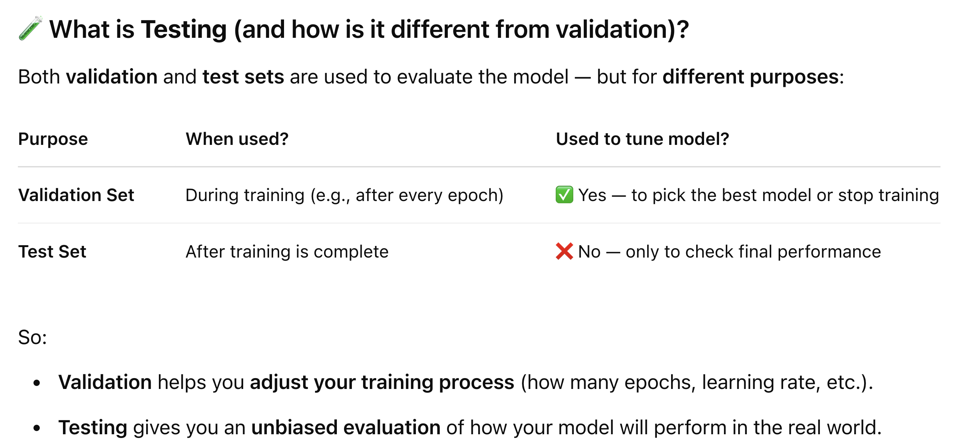
Quiz Option I: Machine learning training pipeline explanations

Slide 8
Quiz Option I: Machine learning training pipeline explanations
🗓️ Training Schedule
🔁 Step-by-Step: What Happens During Training
✅ Step 1: Dataset Preparation
You split your dataset into:
Training set (e.g., 80%)
Validation set (e.g., 10%)
Test set: (e.g., 10%, held until the very end)

Slide 9
Quiz Option I: Machine learning training pipeline explanations
🗓️ Training Schedule
✅ Step 2: Training in Batches (Within Each Epoch)
Imagine:
Training set: 1,000 samples
Batch size: 10 Then:
Each epoch = 1,000 ÷ 10 = 100 batches
🧠 Each batch = 1 training step
For every batch:
The model predicts outputs
The model compares its predictions to the true answers (computes loss)
The model updates its internal weights to improve
This repeats for every batch in the epoch.

Slide 10
Quiz Option I: Machine learning training pipeline explanations
🗓️ Training Schedule
✅ Step 3: Validation After Epoch (or Every Few Steps)
After the model finishes going through all batches in one epoch, you usually:
Pause training
Evaluate the model on the validation set:
No updates, just forward passes
Measure validation loss, maybe perplexity, or task-specific metrics
Why? To monitor:
Is the model improving overall?
Is it starting to overfit (doing worse on validation while doing better on training)?

Slide 11
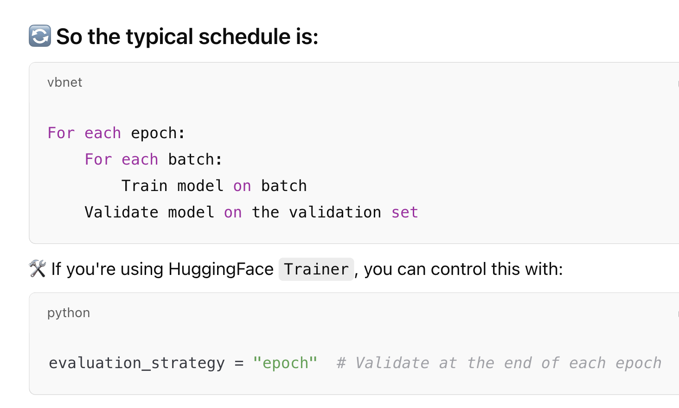
Quiz Option I: Machine learning training pipeline explanations

Slide 12
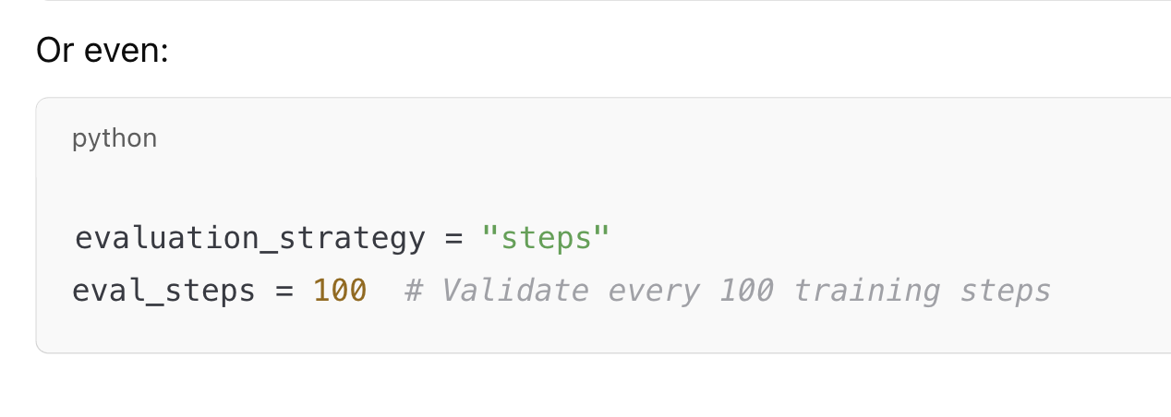
Quiz Option I: Machine learning training pipeline explanations

Slide 13
Quiz Option I: Machine learning training pipeline explanations
🎯 What is Validation Loss Used For?
Validation loss is used to:
✅ 1. Monitor model performance during training
After each epoch (or every few steps), you evaluate your model on the validation set.
The model does not learn during this step — it just predicts and computes loss to show how well it’s generalizing to unseen data.

Slide 14
Quiz Option I: Machine learning training pipeline explanations
✅ 2. Select the best model checkpoint
👉 This is key:
You want to save the version of your model that performs best on the validation set, not just the last one!
Training loss will always go down (because the model is seeing the same data repeatedly).
But validation loss might go down at first, then go up again — which means the model is overfitting.
So you want to track validation loss at each epoch, and keep the model weights that gave you the lowest validation loss.

Slide 15
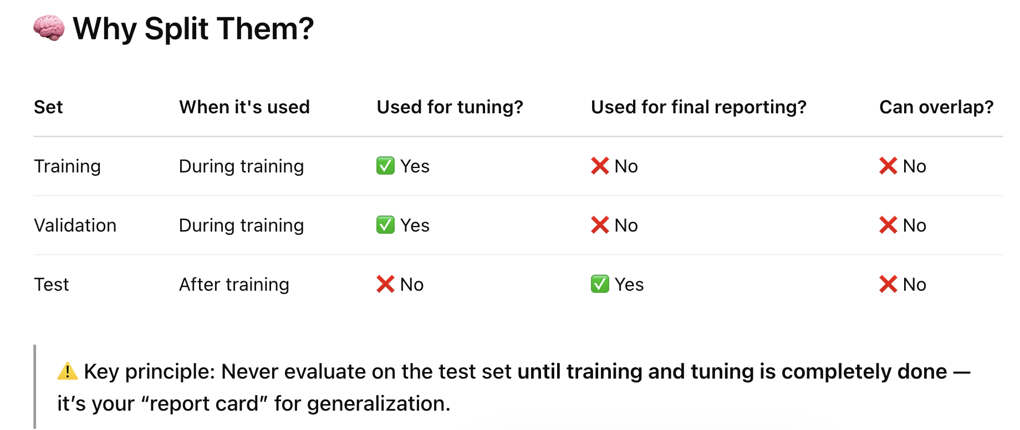
Quiz Option I: Machine learning training pipeline explanations

Slide 16
Quiz Option I: Fine-Tuning a Pre-trained Generative Language Model
Quiz Option II: Simulating a Social Phenomenon with 100+ LLM Agents
Read detailed quiz instructions together

Slide 17
Quiz Option II: Social Simulation pipeline explanations

Slide 18
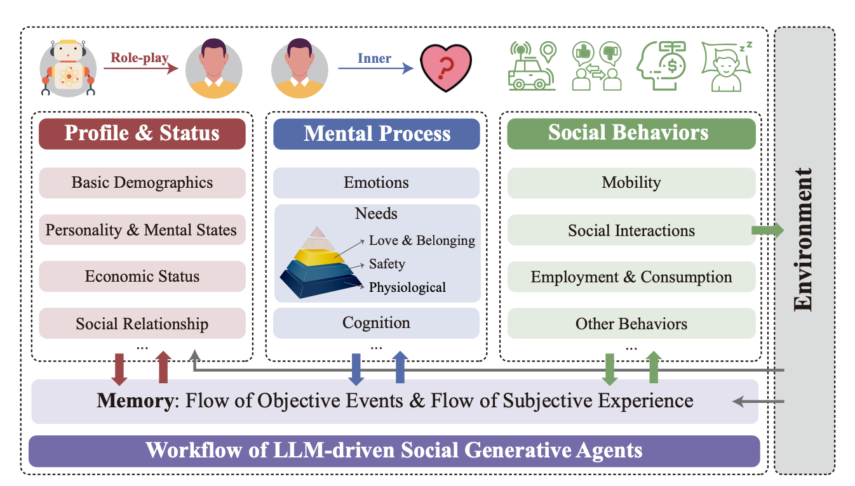
Quiz Option II: Social Simulation pipeline explanations
Agent Architecture:
Piao, Jinghua, et al. "AgentSociety: Large-Scale Simulation of LLM-Driven Generative Agents Advances Understanding of Human Behaviors and Society." arXiv preprint arXiv:2502.08691 (2025).

Slide 19
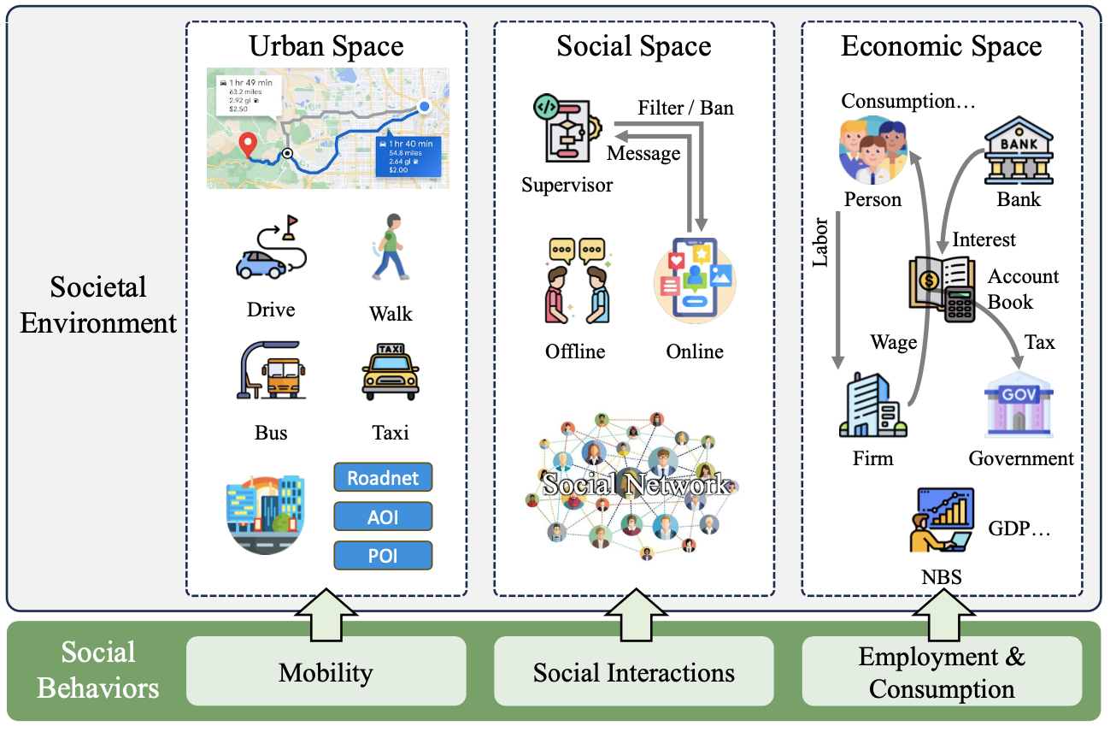

Quiz Option II: Social Simulation pipeline explanations
Urban Space:
Road networks, POIs, multi-modal mobility (walking, driving, public transit).
Data from OpenStreetMap and SafeGraph.
Social Space:
Social networks (family, friends, colleagues) with message filtering (supervisor).
Economic Space:
Macroeconomic modeling (firms, government, banks) with GDP tracking.
Fig ¹
[1] Piao, Jinghua, et al. "AgentSociety: Large-Scale Simulation of LLM-Driven Generative Agents Advances Understanding of Human Behaviors and Society." arXiv preprint arXiv:2502.08691 (2025).

Slide 20
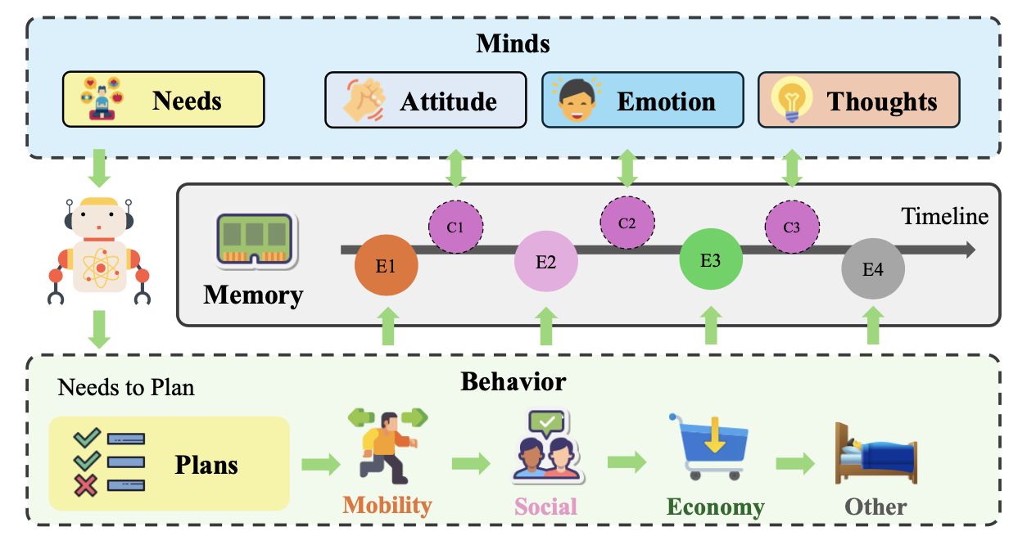
Fig ¹
[1] Piao, Jinghua, et al. "AgentSociety: Large-Scale Simulation of LLM-Driven Generative Agents Advances Understanding of Human Behaviors and Society." arXiv preprint arXiv:2502.08691 (2025).

Slide 21
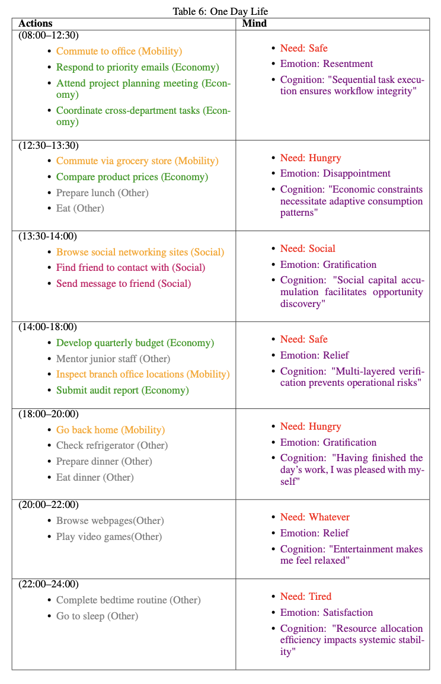

Slide 22
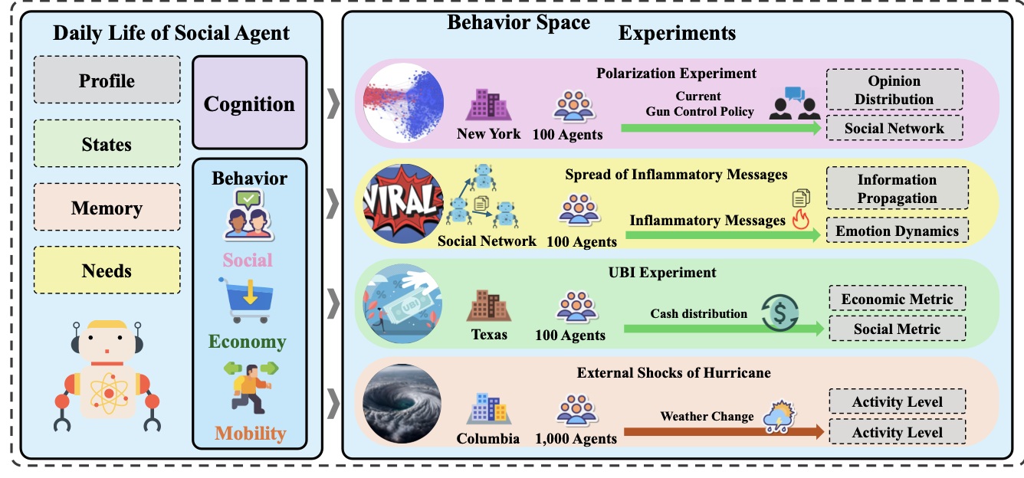
Fig ¹
[1] Piao, Jinghua, et al. "AgentSociety: Large-Scale Simulation of LLM-Driven Generative Agents Advances Understanding of Human Behaviors and Society." arXiv preprint arXiv:2502.08691 (2025).

Slide 23
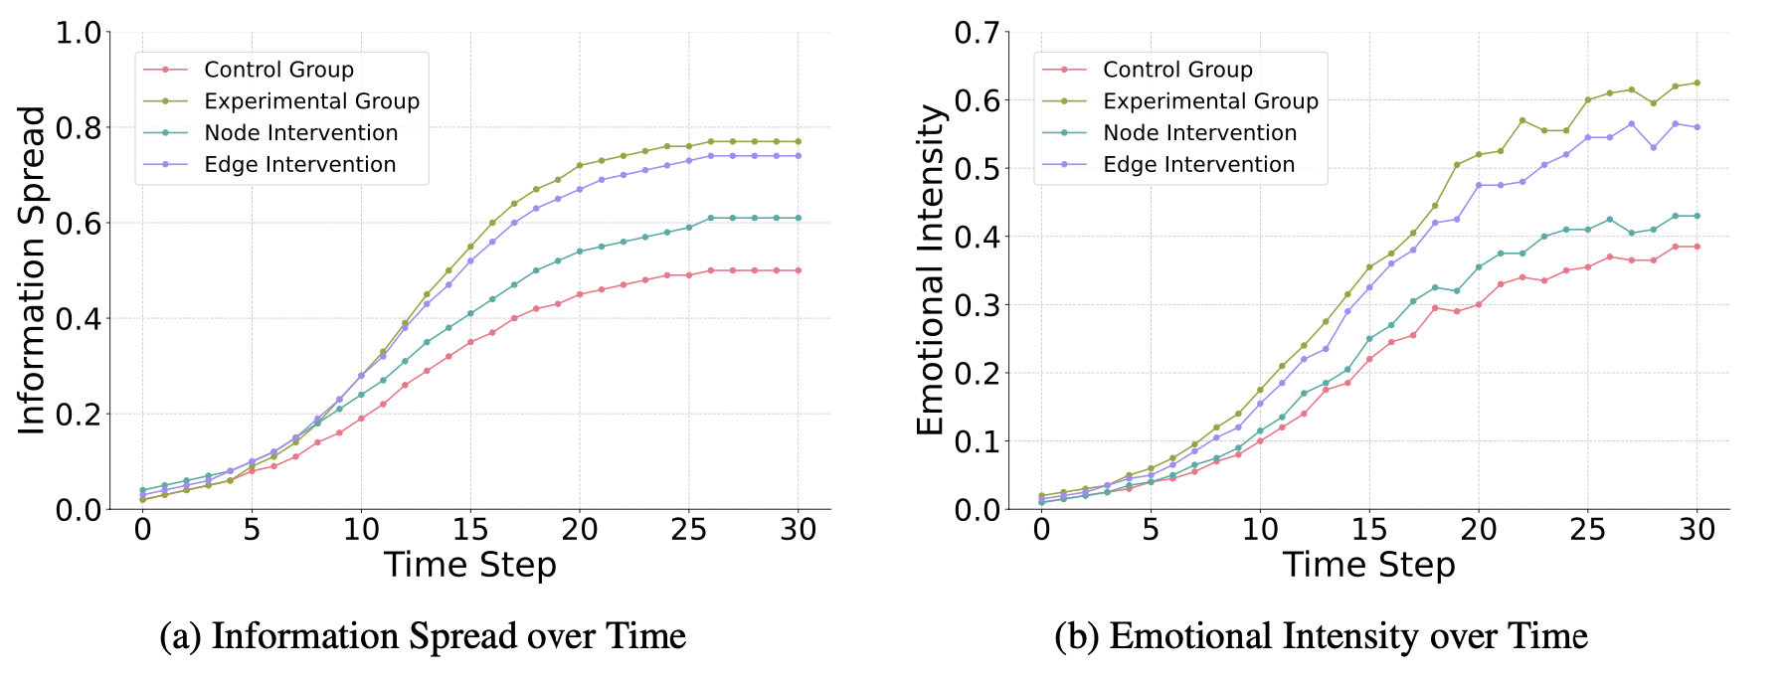
Emergent Behavior Plots
Inflammatory Messages
Fig 1. Simulation results of the spread of inflammatory messages¹
[1] Piao, Jinghua, et al. "AgentSociety: Large-Scale Simulation of LLM-Driven Generative Agents Advances Understanding of Human Behaviors and Society." arXiv preprint arXiv:2502.08691 (2025).

Slide 24
Social Experiments & Case Studies
Universal Basic Income (UBI)
Setup (10k+ agents)
Control Group: Simulated economy without UBI.
Intervention Group: Agents receive $1,000/month unconditionally.
Metrics Tracked: Real GDP, agent consumption levels, depression scores
Key Findings:
Consumption: UBI increased agent spending by 18%, stabilizing economic fluctuations.
Mental Health: Depression levels (CES-D scores) decreased significantly, aligning with real-world UBI trials in Texas.

Slide 25
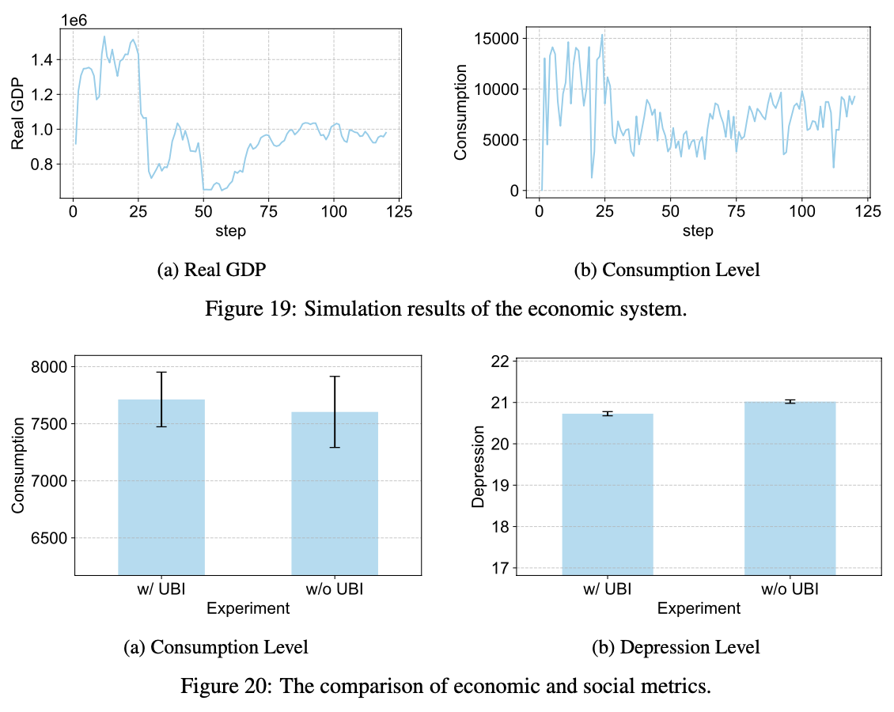
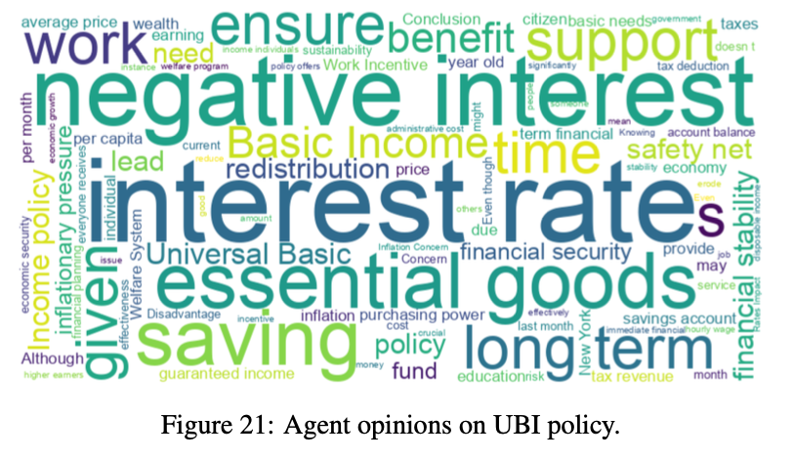
Emergent Behavior Plots
[1] Piao, Jinghua, et al. "AgentSociety: Large-Scale Simulation of LLM-Driven Generative Agents Advances Understanding of Human Behaviors and Society." arXiv preprint arXiv:2502.08691 (2025).

Slide 26
Social Experiments & Case Studies
Hurricane Impact
Setup
1,000 social agents
real-time weather updates to influence agent behaviors
Metric:
Activity Level: traveling individual/area population.
Total daily trip: 9-day normalized time-series
Key Findings:
when the hurricane arrived, activity level sharply decreased to approximately 30%
After the hurricane passed, the activity level gradually returned to normal levels

Slide 27
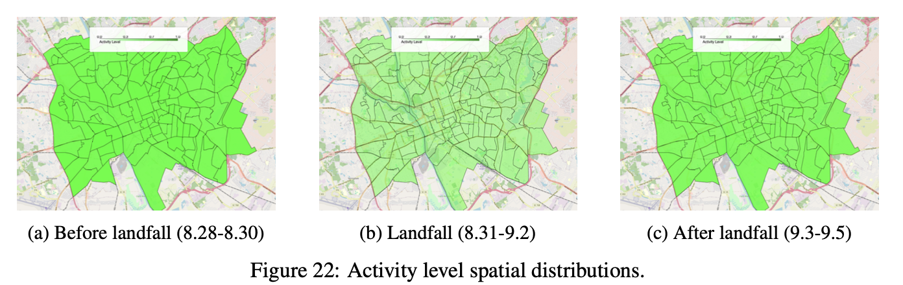
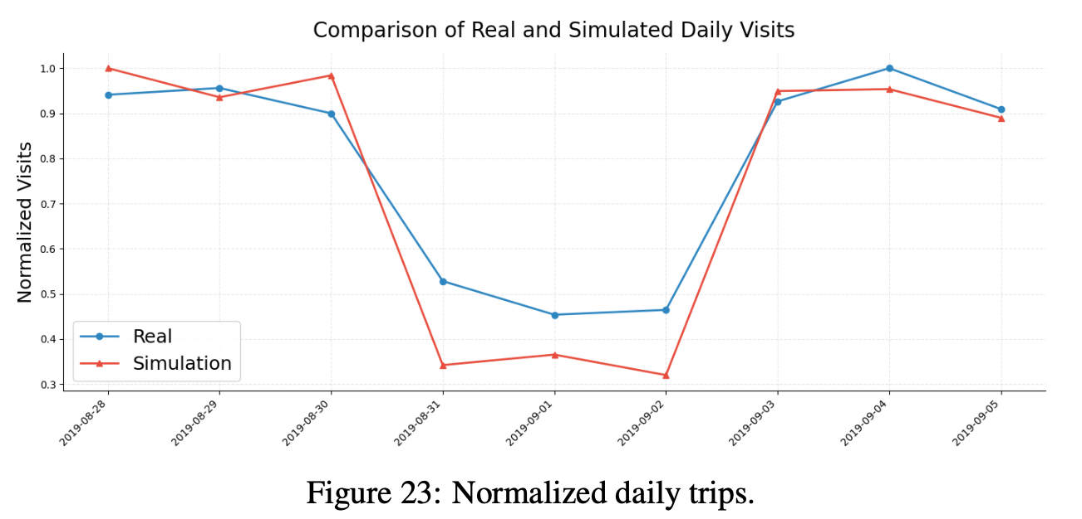
Emergent Behavior Plots
[1] Piao, Jinghua, et al. "AgentSociety: Large-Scale Simulation of LLM-Driven Generative Agents Advances Understanding of Human Behaviors and Society." arXiv preprint arXiv:2502.08691 (2025).

Slide 28
Project 1-1 discussions
Liu Xiaoyan, Yan Weitai, Wang Yitong, Yang Jiahao, Wang Zitong, Wu Kewei，Liu Zhuoyu

Slide 29
Paper Sharing -1

Slide 30
Multiagent Finetuning: Self Improvement with Diverse Reasoning Chains
Author: Vighnesh Subramaniam, Yilun Du, Joshua B. Tenenbaum, Antonio Torralba, Shuang Li, Igor Mordatch
Presenter: Wenwen ZHOU 224030212

Slide 31
01
Background
02
Solution: Multiagent Finetuning
Multiagent Finetuning Process
CONTENTS
03
04
Experiment
05
Analysis
06
Limitations and Conclusions

Slide 32
Background
LLMs' Excellent Performance：GPT-3.5, GPT-4 perform well in language tasks
Limited by Training Data：Have used up much Internet data
Exploration of Self-improvement Methods
Generate Data with Powerful Models
Limited by model quality
High-cost
LLMs Generate Synthetic Data
Performance plateaus during repeated training due to reduced diversity (平台期)

Slide 33
Solution: Multiagent Finetuning
Multiagent Finetuning Method
Fine-tune a set of language models from the same base model
Different Roles
Generation agents: Provide initial responses
Critic agents: Evaluate and optimize other models' outputs
Models trained with independent data
Multiagent debate constructs feedback loop

Slide 34
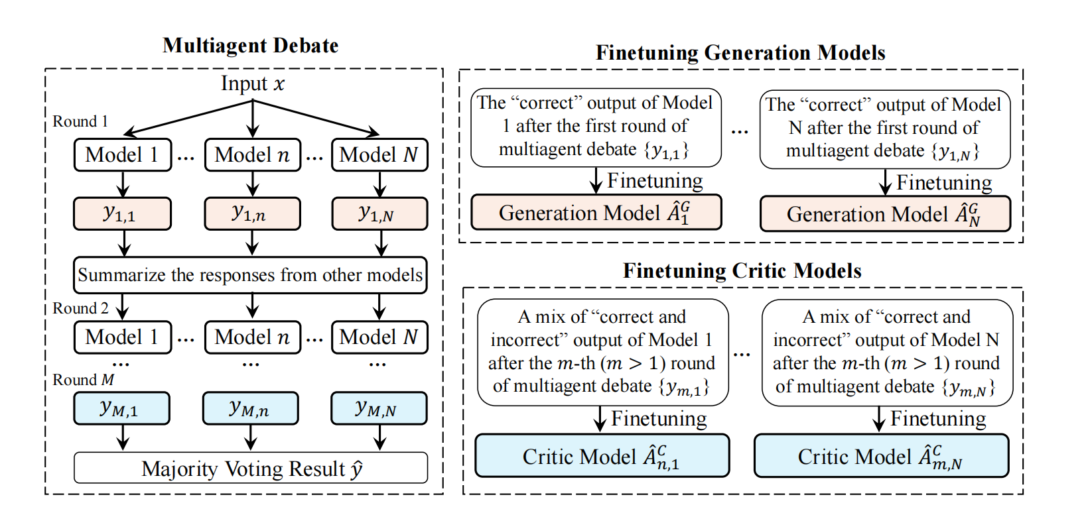
Multiagent Finetuning Overview
Figure: Overview of Multiagent Finetuning

Slide 35
Multiagent Finetuning Process
1
2
Training Models with Different Functions
Fine-tuning Generation Models
Fine-tuning Critic Models
Constructing the Fine-tuning Dataset
Build via multiagent debate
Multiple language models answer a question and then debate
Debate results serve as the fine-tuning dataset

Slide 36
Multiagent Finetuning Process
3
4
Multiple Iterations of
Fine-tuning
Use the fine-tuned models to conduct multiagent debates
Collect data for the next round of fine-tuning to continuously improve model performance
Inference Process
During inference, let the fine-tuned generation and critic agents engage in multiagent debate
Synthesize opinions and obtain the final answer through majority voting

Slide 37
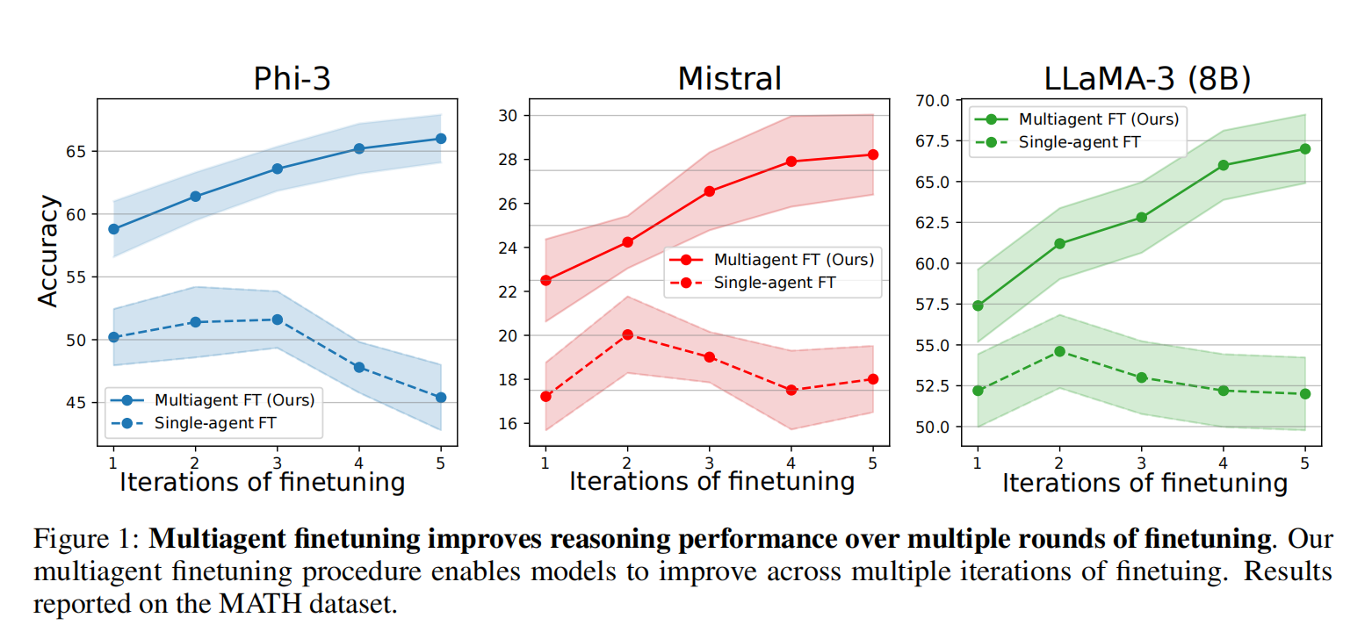
Solution: Multiagent Finetuning
Method Advantages
Promote model specialization and diversification, improve performance
Applicable to open-source and proprietary models, enhance performance
Fine-tuned models generalize zero-shot, outperform baselines
Performance Improvement Data Display

Slide 38
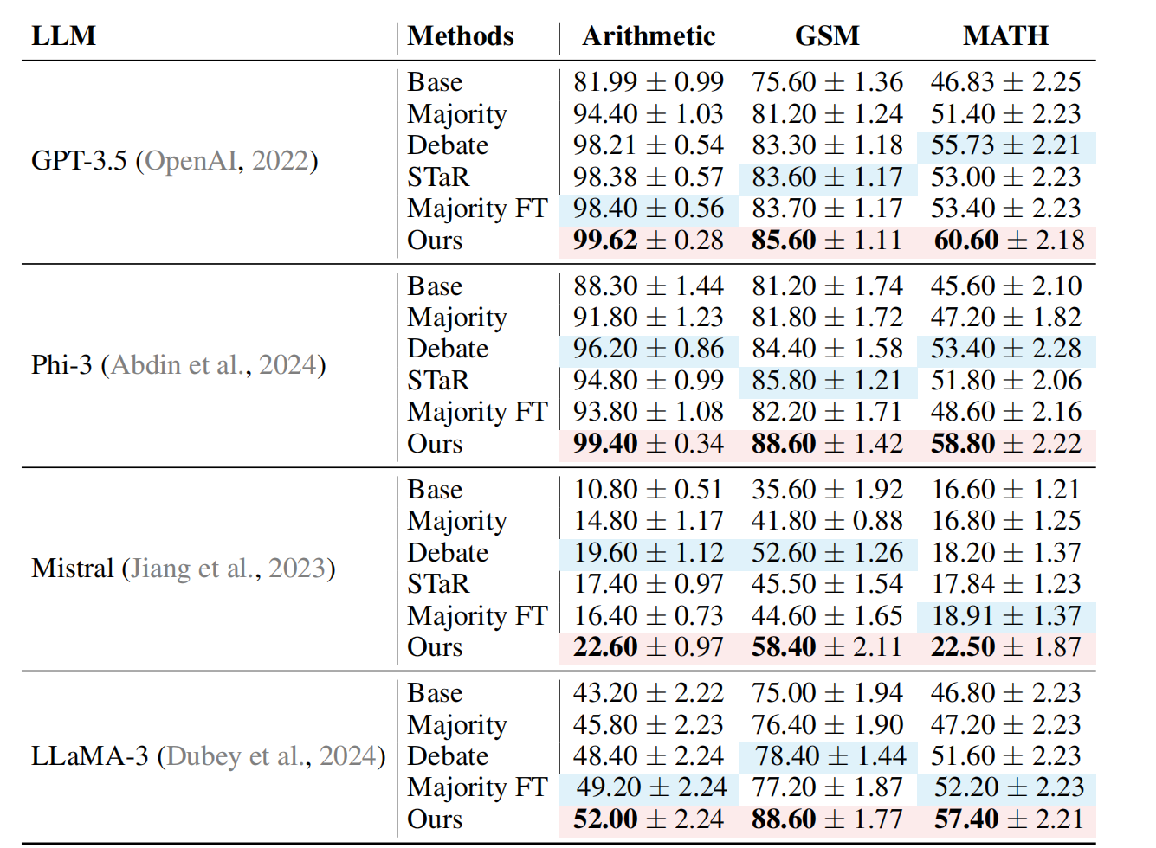
Experiment
Table 1: Quantitative results of the proposed method and baselines.
Tasks
Arithmetic
Grade School Math (GSM)
MATH
Baselines
Compared with: Base (single model), Majority (multiagent majority vote), Debate (multiagent debate), STaR (iterative finetuning with ground truth), Majority FT (majority vote+finetuning).
Quantitative Results
Outperformed all baselines with single finetuning iteration, without ground truth.
E.g., on MATH dataset with Phi-3, their method: 58.8% accuracy; best baseline: 53.4%.
Multiple Iterations
Continuously improved performance.
Phi-3 accuracy rose from 58.8% to 66.0% after 5 iterations.
Single-agent finetuning saturated after 1 iteration and then declined.

Slide 39
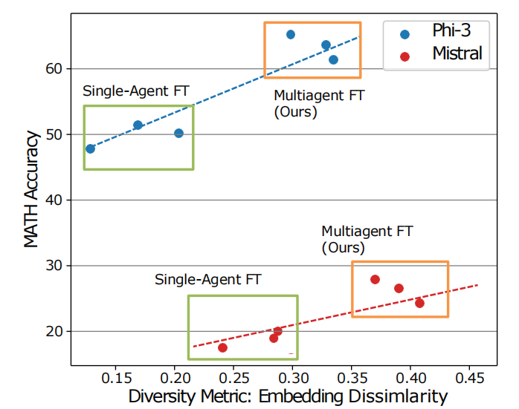
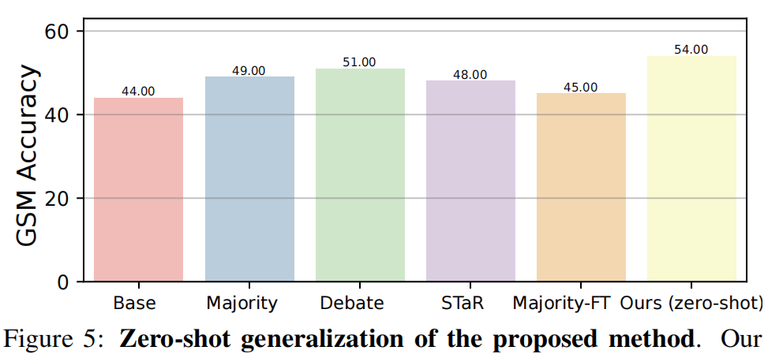
Analysis
Ablation Studies（消融）
Key components (summarization, agent combo, multiagent FT, debate) improve performance
Removing them hurts performance
Response Diversity
Their method boosts diversity
Measured by NLL and embedding dissimilarity
Diversity stays/improves
single-agent FT's drops
Zero-Shot Generalization
Finetuned agents generalize to new datasets
Outperforms baselines on different datasets

Slide 40
Limitations and Conclusions
Limitations
Costly: Higher training & inference cost
Hardware: Demands multiple GPUs, high memory, long inference
Solutions: Share weights, distill debate or quantize
Conclusion
Performance: Boosts performance & diversity
Feedback: Improves feedback, overcomes single-agent limits
Self-improvement: Enables iterative gains in reasoning
Applicability: For open-source & proprietary LLMs
Future: Integrate with other methods, new research

Slide 41
THANKS

Slide 42
Paper Sharing -2

Slide 43


The Unequal Adoption of ChatGPT Exacerbates Existing Inequalities among Workers
Name：Wang Yitong

Slide 44
CONTENT
Materials and Methods
Discussion and Results
Policy Implication

Slide 45
01
Materials and Methods

Slide 46
Research Design
How to choose the occupation that be tested ?
The authors used an expert assessment from Eloundou to identify occupations that are exposed to ChatGPT.
This was used to assess whether using ChatGPT could halve the time it would take an average person to complete a task of the same quality.
Items included at least one job task that was related to ChatGPT and enough workers to allow statistical analysis.
11 occupations: accountants, customer support specialists, financial advisors, HR professionals, IT support specialists, journalists, legal professionals, marketing professionals, office clerks, software developers, and teachers.
Sample
They invited 100,000 workers from 11 occupations to participate in the survey, after multiple rounds of checking, they collected 18,000 valid questionnaires.

Slide 47
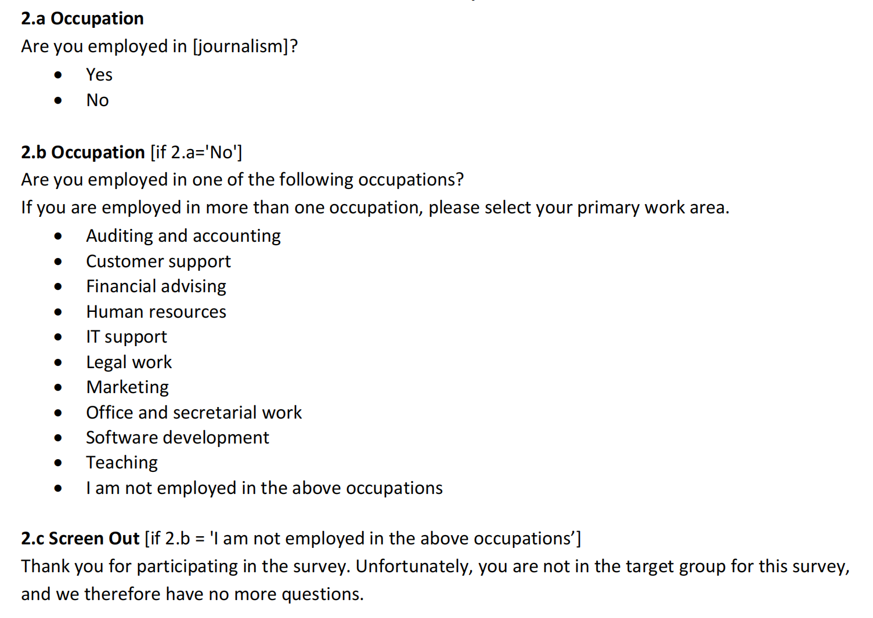
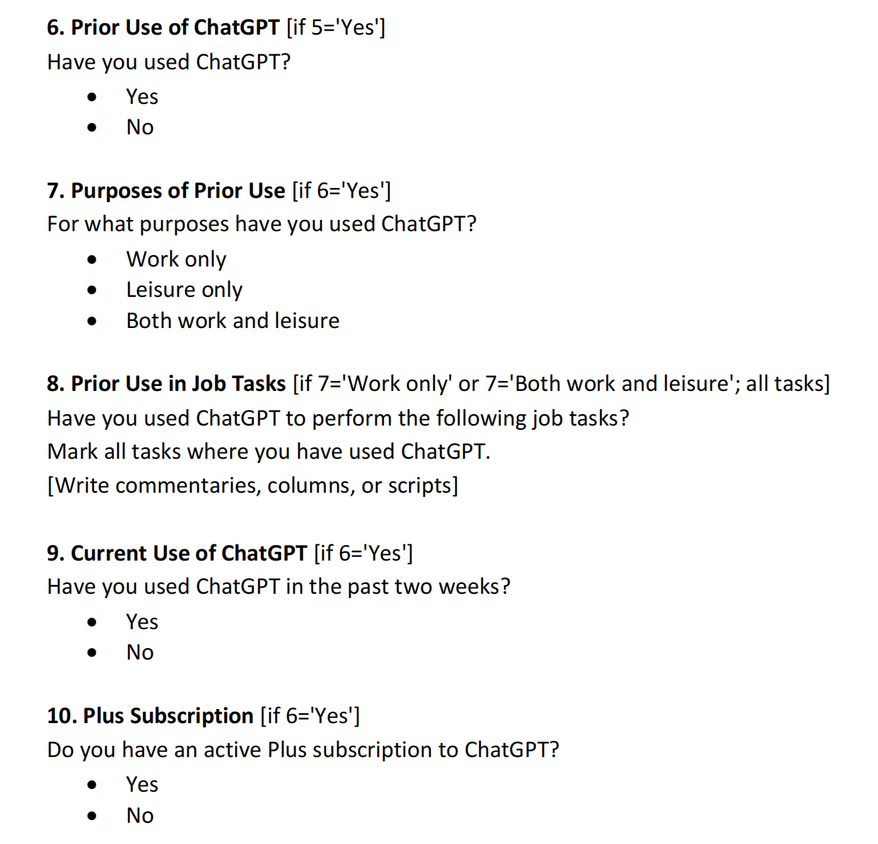
Questionnaires

Slide 48
02
Discussion and Results

Slide 49
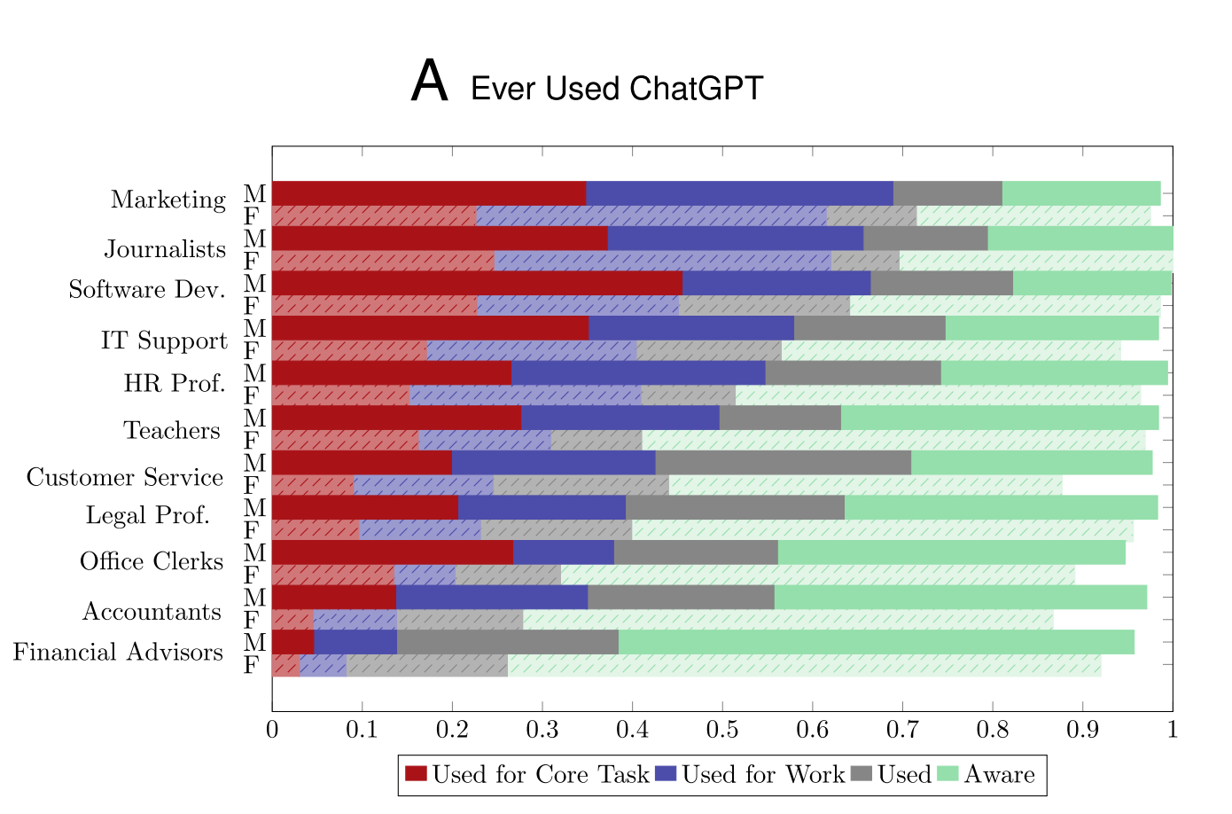
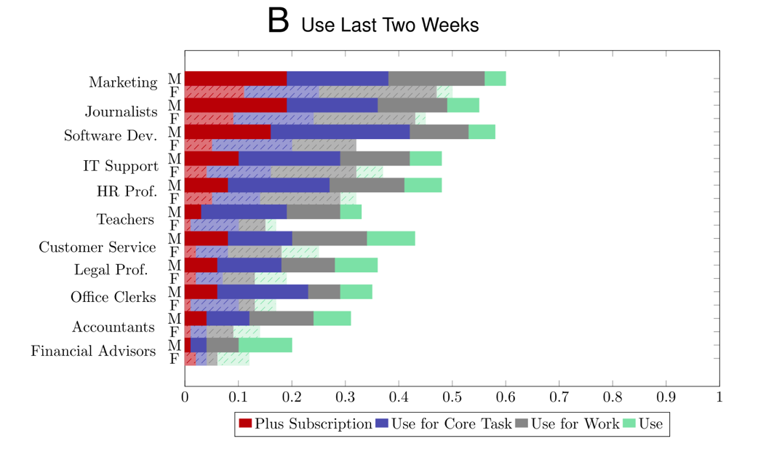
Adoption of ChatGPT
ChatGPT is widespread in the exposed occupations. More than half of workers have used ChatGPT , 41% have used it for work.
Adoption rates differ across occupations. jobs where writing is essential (marketing specialists and journalists), the rates of adoption around 64%. Occupations that handle sensitive information(financial advisors and accountants) have the lowest adoption rates, around 18%.
Not all workers who have ever used ChatGPT are still actively using it. In the last 2 week, 34% have used it, and only 29% have used it for work.

Slide 50
Findings
Young workers with less work experience are more likely to use ChatGPT. For each additional year of age or work experience, the chance of using ChatGPT drops by 0.7 and 0.6 percentage points, respectively.
Before the technology was adopted, workers who used ChatGPT already had slightly higher incomes than non-users. This suggests more capable workers were more likely to use ChatGPT, and the technology has not effectively benefited low-skilled or low-income individuals.
Female workers are 16 percentage points less likely than male workers to use ChatGPT, a gap that exists across all occupations. It remains at 12 percentage points even after accounting for the same company and the same task. Besides, it remains at 14 percentage points when controlling for workers’ other characteristic.

Slide 51
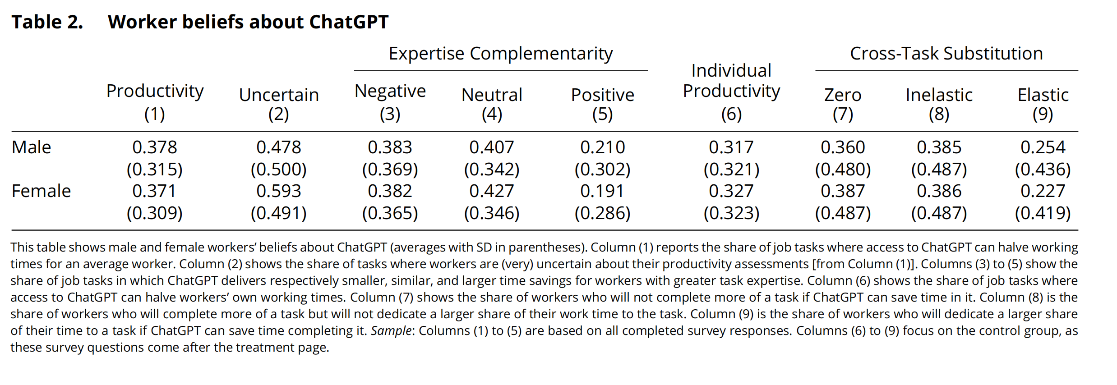
Beliefs about ChatGPT
Table 2 examines how workers anticipate ChatGPT will impact their job tasks
Most workers believe that ChatGPT can significantly improve productivity, and about 37% of work tasks can save half the time due to ChatGPT. (column 1)
Columns (3) to (5) report workers’ perceptions of whether ChatGPT saved less, similar, or more time for workers with greater task expertise. Workers were approximately twice as likely to say that ChatGPT saved less, rather than more time for workers with greater task expertise (38% vs. 20%).

Slide 52
Beliefs about ChatGPT
Table 2 examines how workers anticipate ChatGPT will impact their job tasks
Column (6) shows how workers perceive their own time savings from ChatGPT. They believe it can halve their working times in about 32% of their job tasks. comparing with the typical worker in Column (1), it seems workers are slightly more skeptical about their own productivity gain from ChatGPT.
Columns (7) to (9) show the influence of time allocation. About 37% of employees said they would not perform more tasks if ChatGPT could save time on completing tasks. In contrast, about 24% of employees said they would spend more work time on tasks that ChatGPT could save time on completing. It suggests that in the short term, ChatGPT may lead to limited reallocation between work tasks.

Slide 53
Reasons why workers do not intend to use ChatGPT
42% of employees said they needed training to use ChatGPT.
36% of employees say their employer actively limits their use.
Less than 9% of employees expressed concerns about becoming replaced or overly dependent on ChatGPT.
Differences between different professions
Occupations that deal with sensitive information, such as financial advisors and legal professionals, are more likely to have employer restrictions.
People in occupations with less IT requirements, such as teachers, need training to use ChatGPT.
Customer service representatives avoid using ChatGPT because they fear being replaced it.
In professions where writing is a core skill, such as journalism, people believe that ChatGPT reduces their enjoyment of their work.
The influence of workers believes: The researchers randomly showed participants an expert's assessment of the time savings of ChatGPT. Although the expert's assessment changed the workers' beliefs, it had little effect on their intention to use ChatGPT.

Slide 54
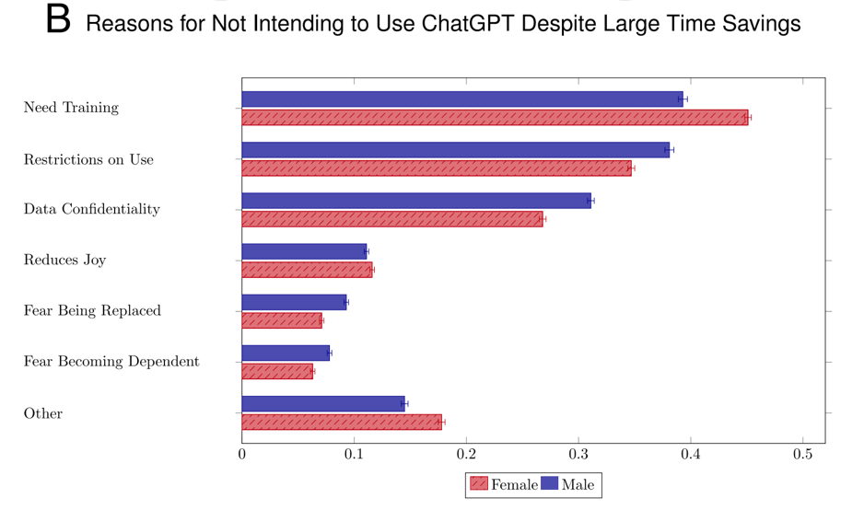
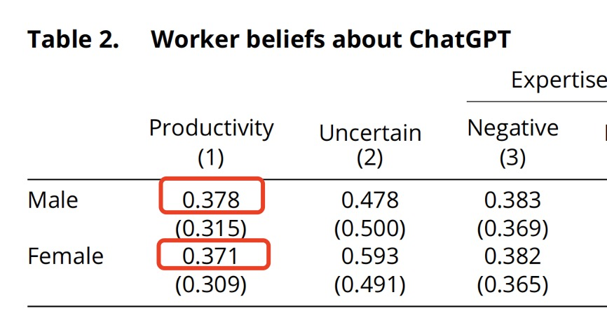
Difference in Gender
From previous table 2 we could see that women are as optimistic as men about the time savings from ChatGPT. (37.8% vs 37.1%)
From the figure above, we could conclude that, in the use of ChatGPT, women more frequently face the barriers from "lack of training”, whereas men are more often constrained by corporate restrictive policies and concerns over data confidentiality.

Slide 55
03
Policy Implication

Slide 56
Policy Implication
The absence of training limits people's use of ChatGPT.
Therefore, enterprises and governments should take positive measures to address this issue by providing appropriate training programs and policy support.
These efforts should focus on supporting low-income workers, less experienced individuals, and female workers to effectively utilize this technology, thereby reducing barriers to adoption and promoting equitable access to the benefits of generative AI.

Slide 57
Paper Sharing -3

Slide 58

How to evaluate the cognitive abilities of LLMs
Authors：Anna A. Ivanova
Presenter：Xinyi Wang Date：2025.4.1

Slide 59
1. Background and Motivation
The article begins by highlighting the historical context of evaluating machine intelligence through language, dating back to the Turing test. With the rapid advancement of LLMs like ChatGPT, researchers have started using language-based tests originally designed for humans to assess these models. However, while conducting such tests is straightforward, interpreting their results remains challenging.
Key Questions:
How should we evaluate the cognitive abilities of LLMs?
If an LLM passes a human cognitive test, does it truly possess the corresponding cognitive ability?
How can we design tests to minimize the use of "shortcuts" (e.g., statistical associations) rather than genuine cognitive skills?

Slide 60
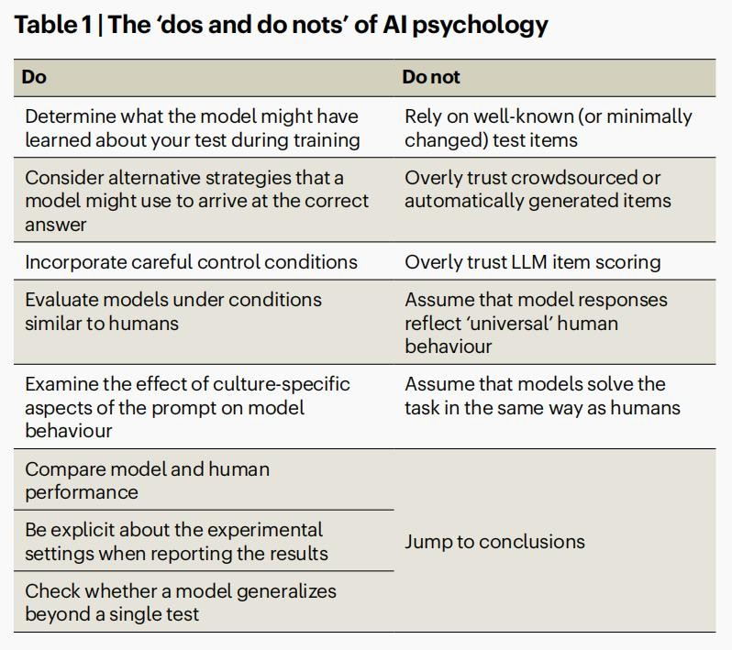
2. Experimental Design
The author proposes 14 methodological "Do and Don'ts" for designing and interpreting studies on LLM cognitive abilities. Key recommendations include:

Slide 61
Experimental design
Do determine what the model might have learned about your test during training.
Do consider alternative strategies that a model might use to arrive at the correct answer. Do incorporate careful control conditions.
Do not rely on well-known (or minimally changed) test items.
Do not overly trust crowdsourced or automatically generated items.
Do evaluate models under conditions similar to humans when comparing their performance. Do examine the effect of culture-specific aspects of the prompt on model behaviour.

Slide 62
The Winograd Schema Challenge
In 2012, Levesque and colleagues proposed a test for diverse kinds of basic world knowledge, named after an initial example by Terry Winograd. The test includes minimally different item pairs with pronouns whose referent can be inferred based on general world knowledge:
Question: The trophy doesn’t fit into the brown suitcase because it’s too small. What is too small?
Answer: The suitcase.
Question: The trophy doesn’t fit into the brown suitcase because it’s too large. What is too large?
Answer: The trophy.
A set of such minimally differing sentence pairs, addressing various world knowledge phenomena (e.g., physical properties, biology, social situations), was compiled into the Winograd Schema Challenge (WSC). While initially challenging, the WSC was largely solved by 2020, with large language models (LLMs) achieving over 90% accuracy. However, this success did not reflect the models' deep understanding of the world but rather flaws in the test itself.

Slide 63
Key Issues with the WSC
Simple Heuristics
The original paper cautioned against using examples solvable via simple heuristics, such as:
Selectional restrictions: For example, "The women stopped taking the pills because they were pregnant/carcinogenic." Here, only an animate entity can be pregnant, and only an inanimate entity can be carcinogenic, creating an unambiguous association without requiring deeper world knowledge.
Frequency effects: For example, "The race car zoomed by the school bus because it was going so fast/slow." A simple association between "race car" and "fast" suffices to determine the referent.
The authors also emphasized that examples should be "Google-proof" (i.e., not present in online text corpora used to train the models).
Flaws in the Original Dataset
Despite awareness of these heuristics, constructing a heuristic-free dataset proved difficult. Over 10% of the original WSC items had simple association-based solutions. To address this, Sakaguchi et al. created WinoGrande, a large dataset where examples were first crowdsourced online and then automatically filtered to reduce co-occurrence-based associations using language model embeddings. This filtering significantly reduced model performance, indicating that association heuristics inflated accuracy.

Slide 64
3. Interpreting Results
When interpreting the results of a cognitive assessment, the following factors are important.
Do compare model and human performance.
Do be explicit about the experimental settings when reporting the results. Do not overly trust LLM item scoring.
Do not assume that model responses reflect ‘universal’ human behaviour. Do not assume that models solve the task in the same way as humans.
Do check whether a model generalizes beyond a single test. Do not jump to conclusions.

Slide 65
4. Open vs. Closed Models
The article discusses the challenges of evaluating closed models (e.g., proprietary industry models) versus open models (e.g., academically developed models):
Open Models: Allow researchers to access training data and algorithms, enabling rigorous validation and reproducibility.
Closed Models: Lack transparency, making results harder to interpret. However, they are valuable for practical applications.
5. Conclusion and Recommendations
The author concludes that scientific practices in AI psychology are still evolving. By adhering to methodological rigor, future research can more accurately assess LLM cognitive abilities while acknowledging their strengths and limitations. The article suggests prioritizing open models for foundational research and using closed models for applied studies, with caution regarding reproducibility.

Slide 66
Answers：
How to Scientifically Assess LLMs' Cognitive Capabilities?
Avoid Data Contamination: Ensure test tasks/data are not part of the model’s training set (e.g., use newly designed test items).
Diverse Testing: Evaluate generalization through multi-task, multi-format assessments (text, images, logic problems).
Compare with Human Performance: Test humans and models under identical conditions, analyzing error patterns.
Controlled Experiments: Design baseline conditions (e.g., removing key information) to detect statistical shortcuts.
If an LLM Passes a Human Cognitive Test, Does It Truly Possess That Ability?
Example: In Winograd Schemas, models may use word-frequency associations (e.g., "race car → fast") rather than genuine reasoning.
Even with correct answers, models may use entirely different strategies (e.g., pattern matching vs. human analogical reasoning).
Conclusion: Passing a test is a necessary but insufficient condition—multi-dimensional evidence is required.

Slide 67
3. How to Design Tests That Minimize "Shortcuts"?
Adversarial Design:
Add counterintuitive items (e.g., "Ice is hotter than fire because ").
Use minimal contrast pairs (e.g., Winograd Schemas) to eliminate superficial cues.
Dynamic Test Sets:
Regularly update test items to prevent memorization (e.g., WinoGrande’s crowdsourced dataset expansion).
Causal Validation:
Remove critical information—if models still "guess correctly," bias is likely at play (e.g., Elazar’s baseline experiments).
Multimodal Testing:
Combine text, images, and videos (e.g., "Describe physical anomalies in this picture") to reduce text- only statistical exploits.
Case Studies:
Failure: Original Winograd Schema had ~10% of items solvable via word-frequency heuristics.
Success: WinoGrande reduced accuracy by automatically filtering association-biased items.

